Slide 1
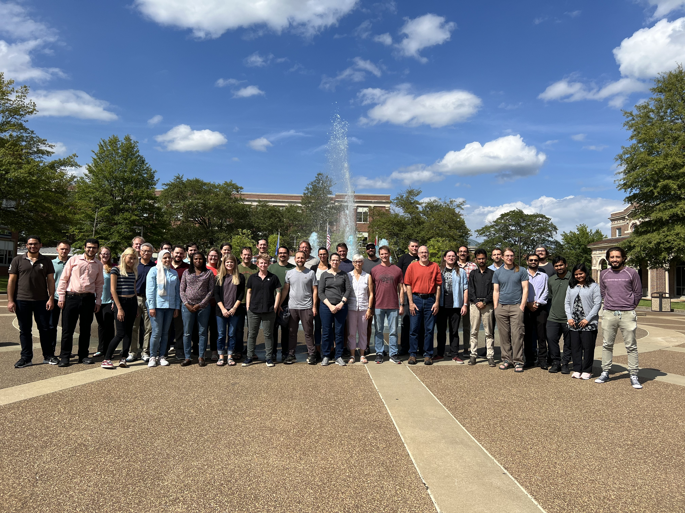
INTRODUCTION TO MODFLOW
September 11-15, 2023, Memphis, Tennessee
Andrew
Collins
Liz
Heal
Connor
Haugh
Adam
Parker
Brad
Harken
Emilia
Bristow
Reid
Brown
Ken
Skinner
Brian
Waldron
Scott
Ducar
Joe
Hughes
Pablo
Jimenez
Max
LIndaman
Ivan
Zamora
Frank
Tsai
Jerry
Melendez
Jessica
Villers
Mike
Fienen
Bojan
Milinic
Courtney
Kemmer
Spencer
Smith
Khairul
Hasan
Michael
Attia
Mohammed
Elkharakany
Martha
Nielsen
Steve
Westenbroek
Faraz
Ul Haq
Fahim
Aslam
Rodrigo
Ruiz
Lily
Yang
Aya
Mohammed
Faith
Kuria
Leslie
Duncan
Katie
Hulsey
Sarken
Dressler
Andrea
Hughes
Chris
Langevin
Josh
Larsen
Khayrun
Nahar
Mitu

